Slide 1


But what can we do about it? Actions that can help our rivers and waterways
Louise Barnetson
Water Champion – Parishes & Communities

Slide 2
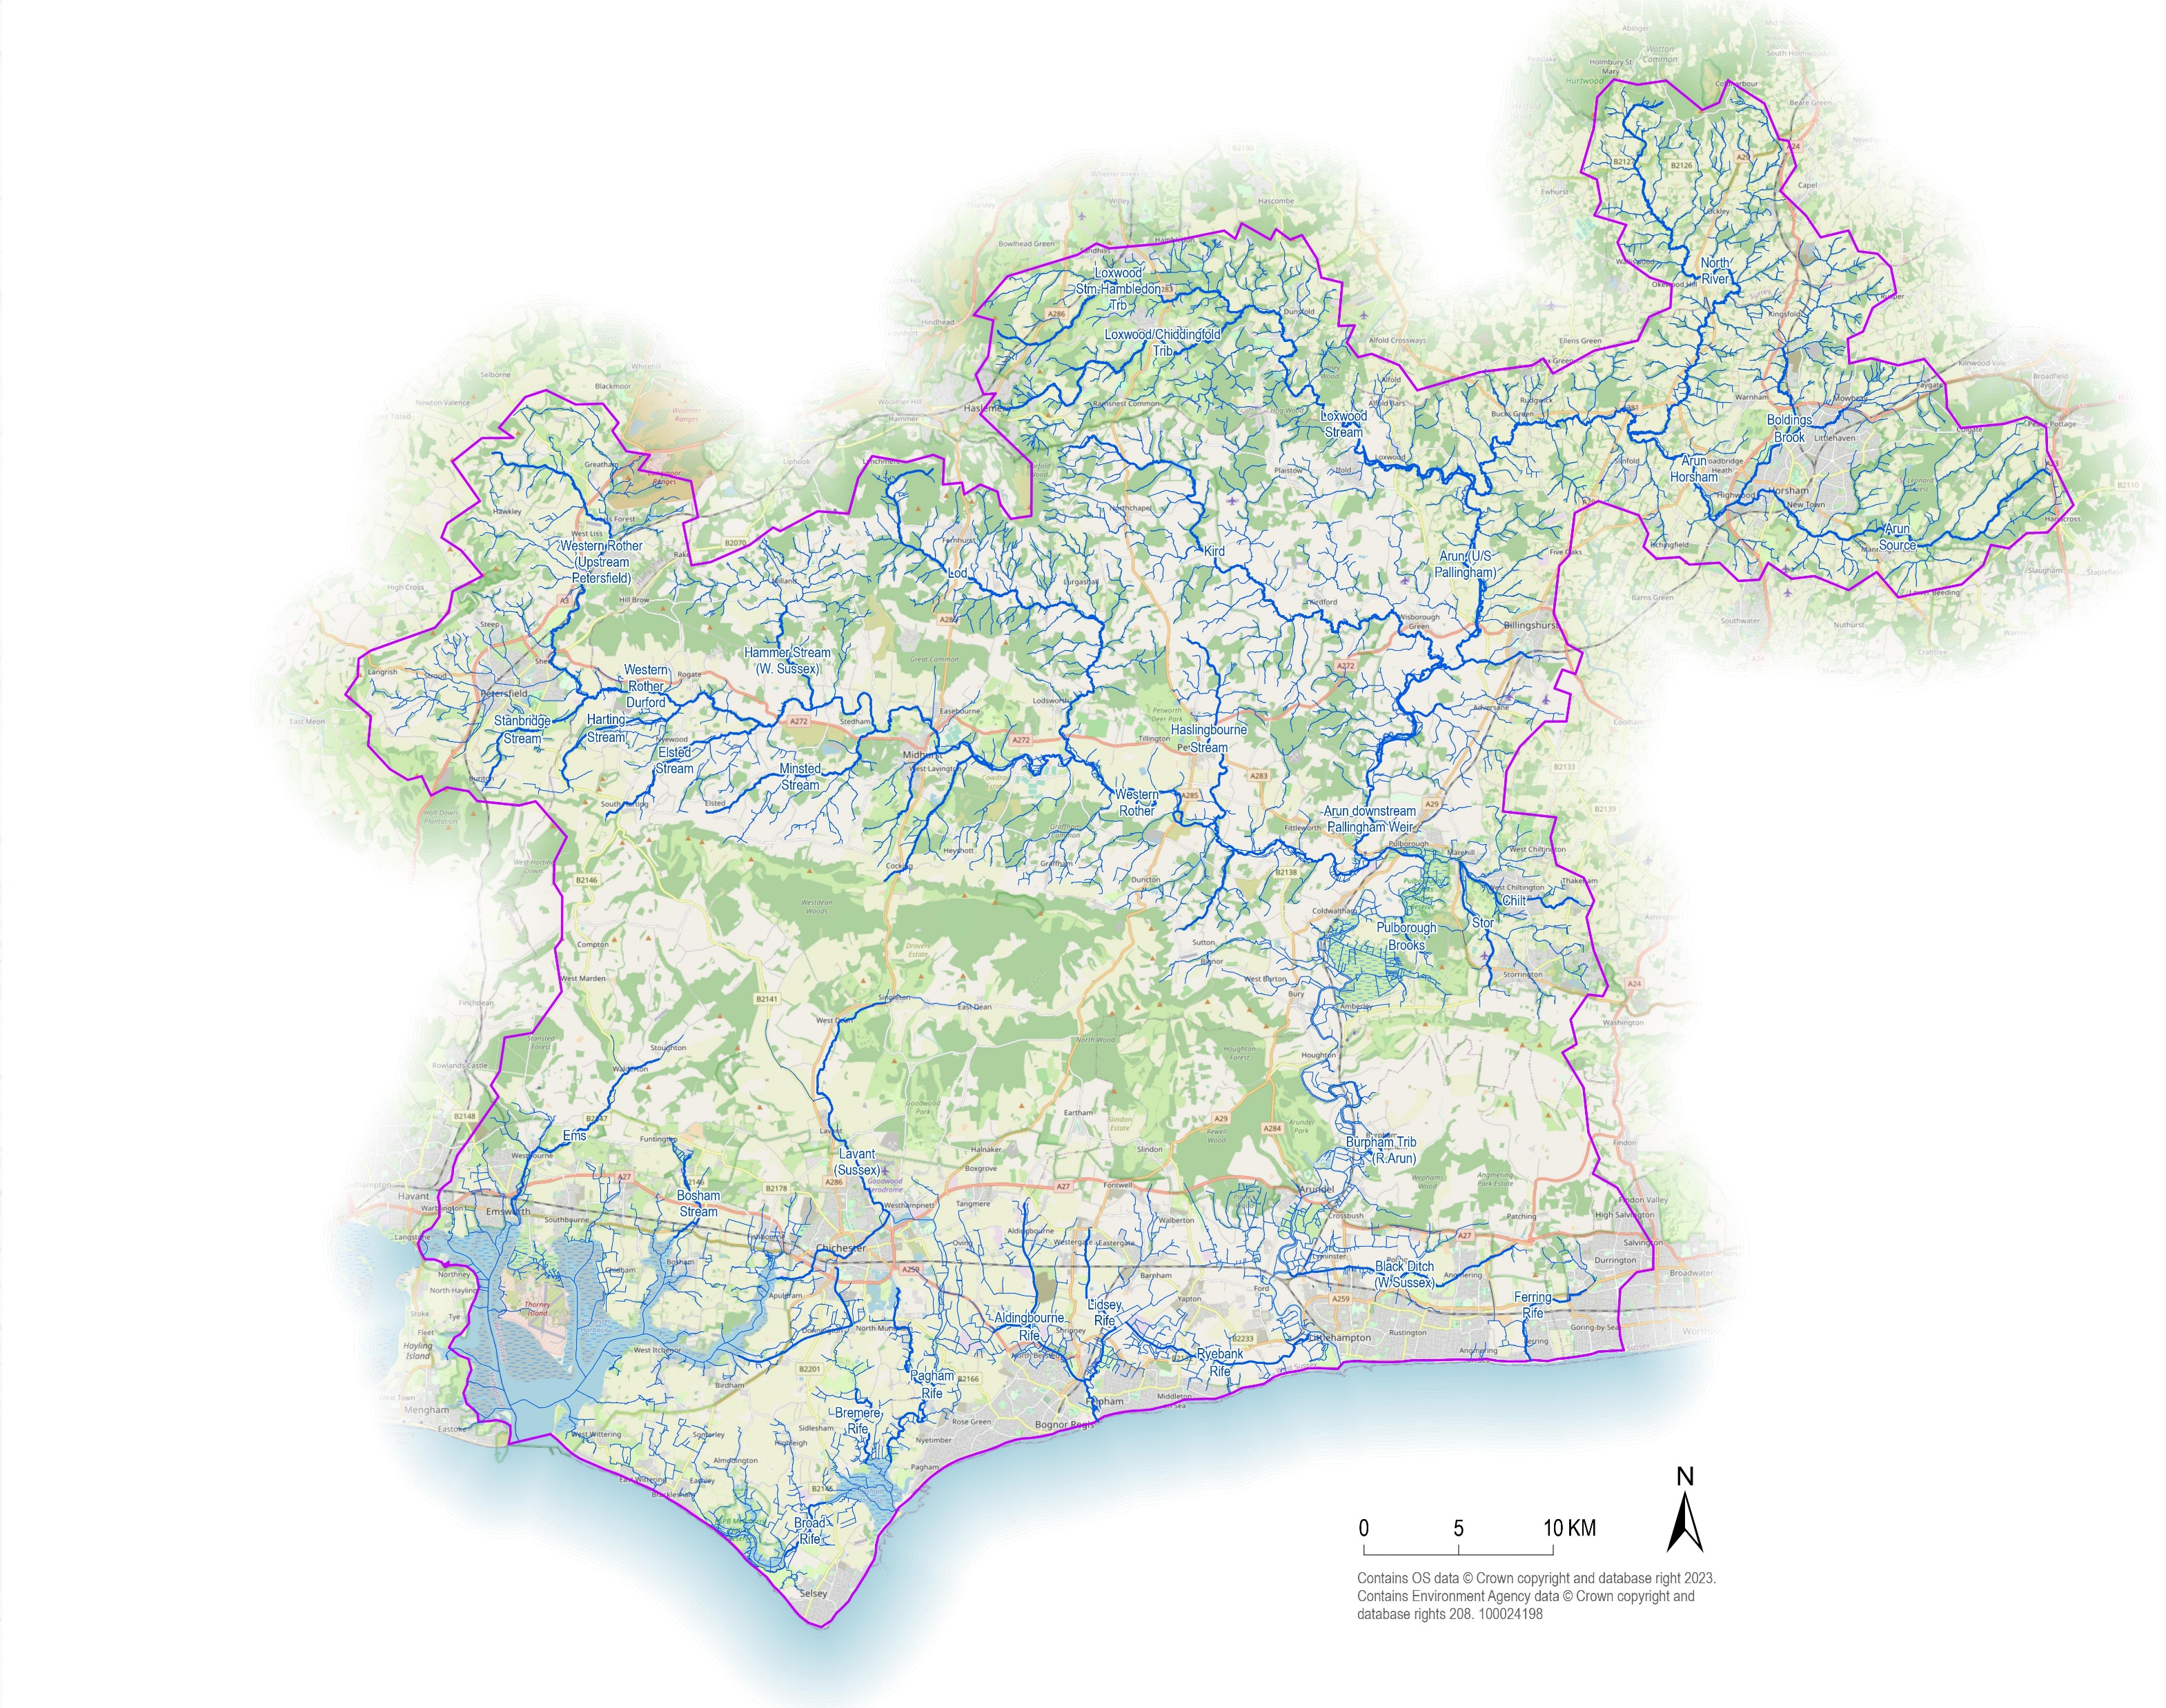
Arun & Western Streams Catchment Area
Notes:
The catchment area for North Mundham is part of the Western Stream Cathcment area – from Emsworth across to Felpham, including the Manhood Peninsula, Chichester, and area north of Chichester to around Singleton, East Dean, Chilgrove, etc.

Slide 3
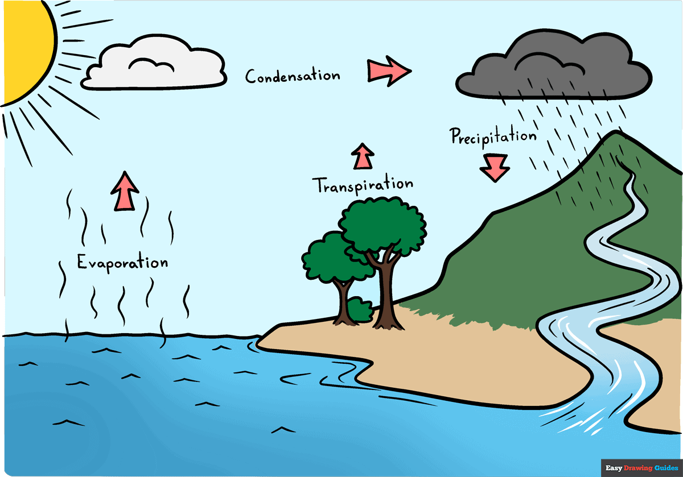

The Water Cycle
The Water Cycle

Slide 4
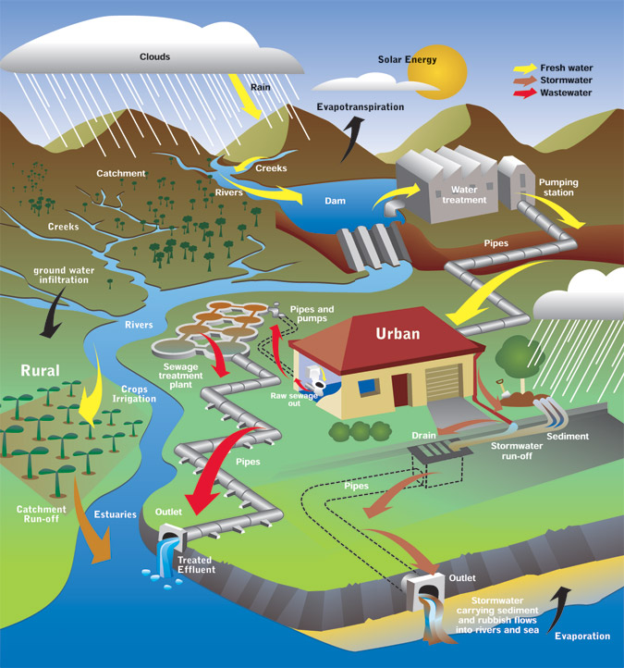
Human Modified Water Cycle
Where does it come from?
Where does it go?
What are we adding to it?
Notes:
Deforestation / Hedgerow removal
Urbanisation - Less infiltration and Increased surface runoff
Agriculture - Polluted runoff containing fertilisers and pesticides
Draining wetlands for farmland
Groundwater Extraction - Over-pumping from aquifers is one of the most serious issues worldwide.
Water Pollution - Industrial waste, sewage, plastics, and chemicals contaminate water sources.
Summary Humans have modified the water cycle by:
Changing evaporation through global warming and irrigation
Changing precipitation through climate change and deforestation
Reducing infiltration through urbanisation
Increasing runoff by removing vegetation and building cities
Altering storage with dams and groundwater extraction

Slide 5
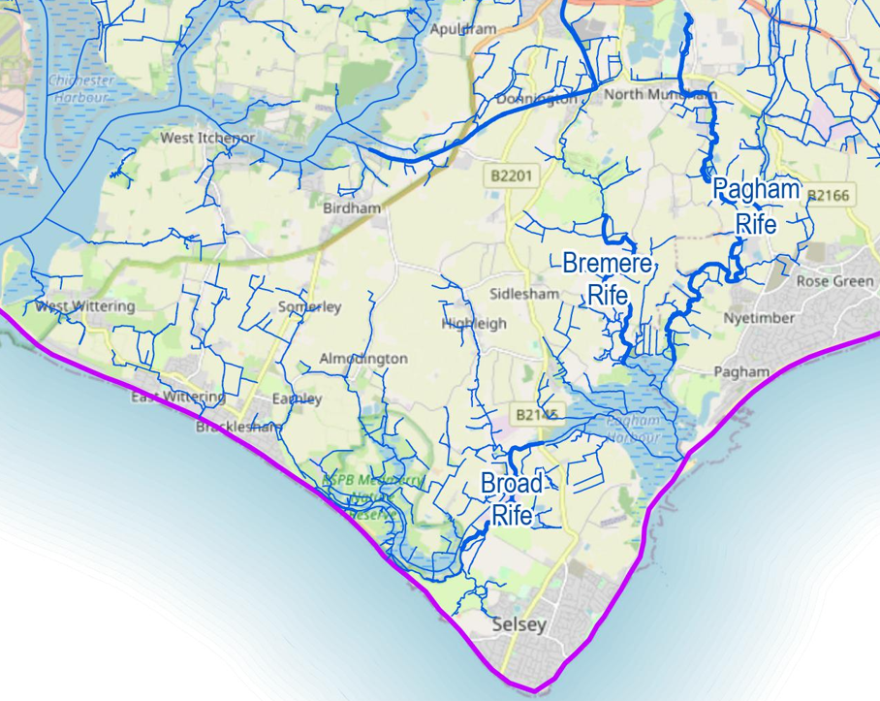


EA classifications (2022)
Bremere Rife
Broad Rife
Pagham Rife
Lavant Water Body
Notes:
Poor chemical status, poor for phosphates – sewage pollution, poor soil management, agricultural runoff, invasive species, low dissolved oxygen, high levels of ammonia, high temperatures.

Slide 6
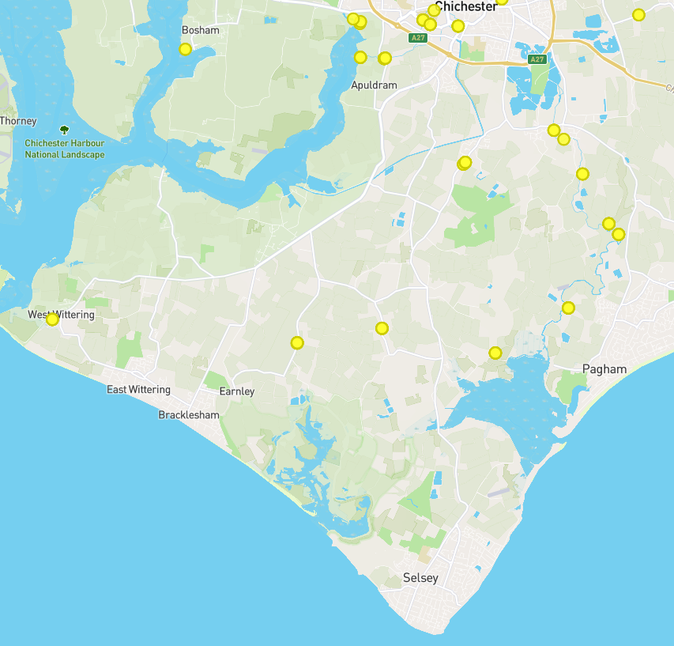
River Guardians
Testing has been carried out monthly by our volunteers from Feb 2024-present
Pagham Rife
Phosphates – average 0.86 ppm
Nitrates – average 3.61 ppm
Bremere Rife
Phosphates – average 0.42 ppm
Nitrates – average 2.48 ppm
Highleigh Rife
Phosphates – average 0.39 ppm
Nitrates – average 7.43 ppm
Almodington Rife
Phosphates – average 0.68 ppm
Nitrates – average 2.68 ppm
Phosphate
Good ecological status in Rivers is between 0.077 – 0.306 ppm
Nitrate
1+ ppm is ‘elevated’, 5+ is excessive. Natural levels of nitrate in freshwater are typically well below 5 ppm
Notes:
David Maclean – Parish councillor & River Guardian (3 vols covering Pagham Rife, 1 covering Bremere)
Testing for phosphates, nitrates, turbidity, temperature, dissolved solids, and a number of observations – the eyes & ears.
Broadly speaking – phosphates & nitrates are high, particularly on Pagham Rife.

Slide 7
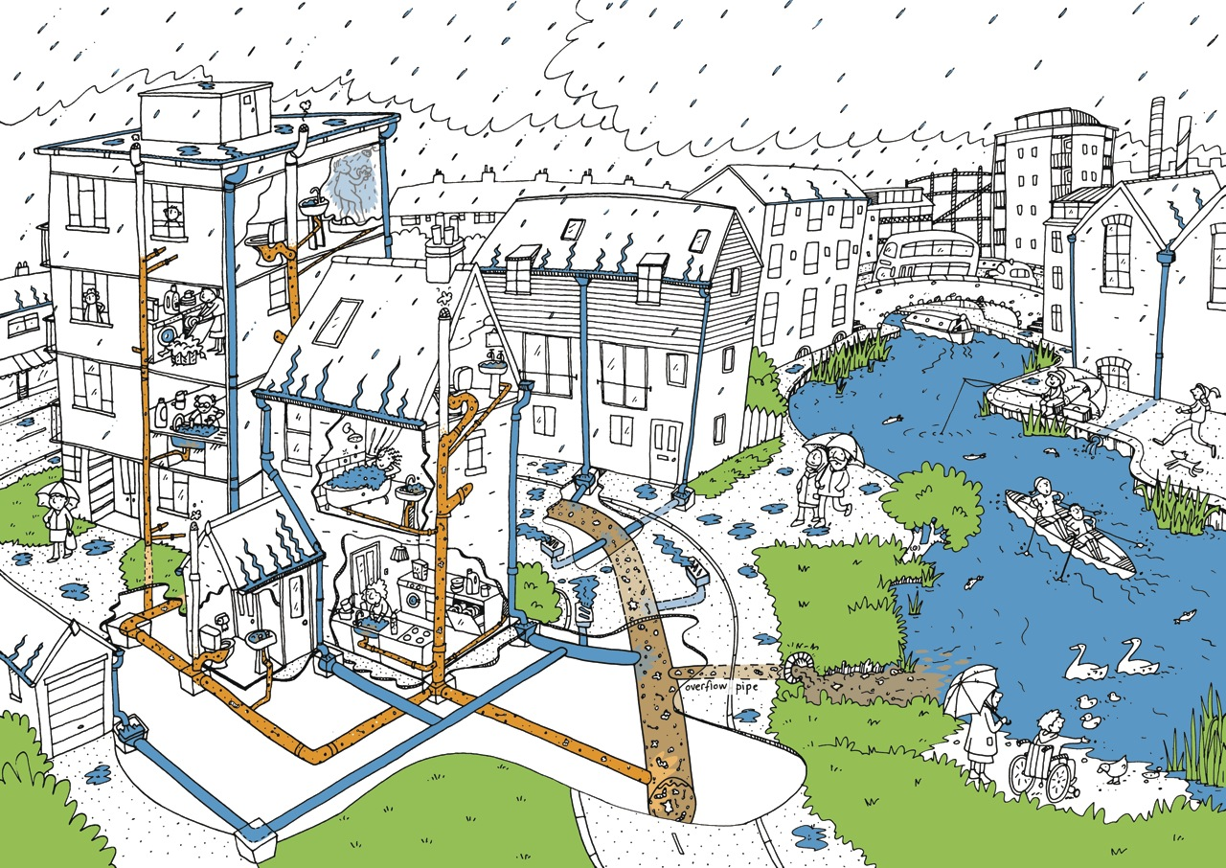
Combined sewer system.
©Thames21

Slide 8
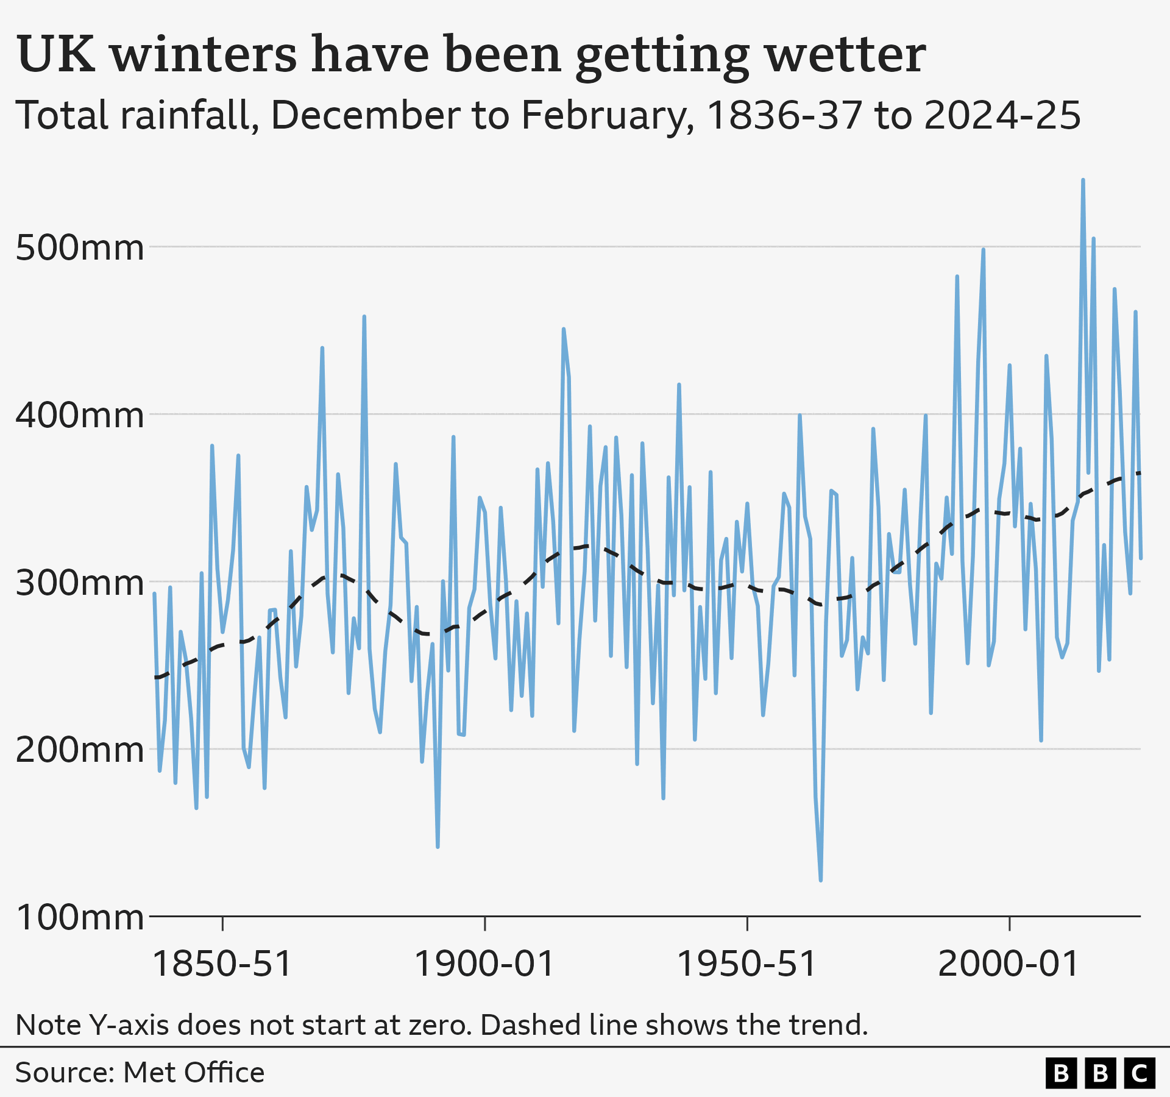
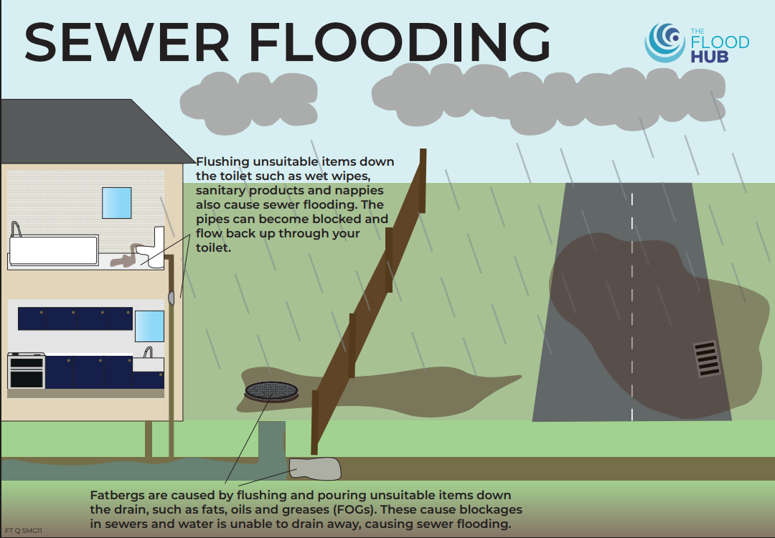
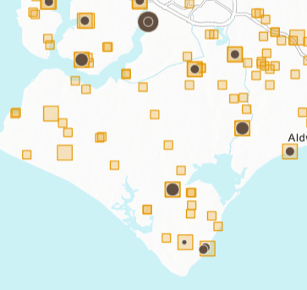
+ Groundwater infiltration
+
Inadequate infrastructure

Slide 9
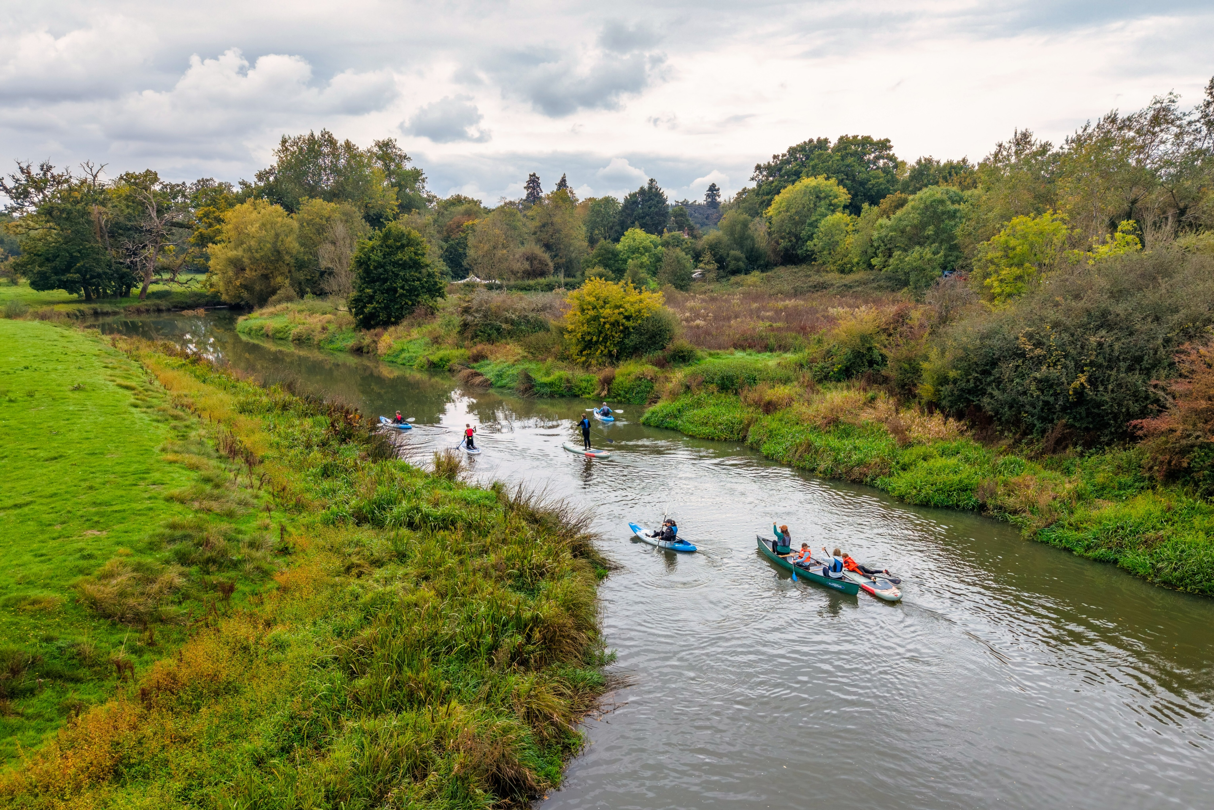
What can we do? Be the Eyes & Ears
Stay informed - live & historic spill data
Rivers Trust Sewage Map Online
Southern Water “Clean Rivers & Seas”
“See It. Say It. Sorted” (sort of!)
Pollution – bad smells, milky water, etc
Litter/flytipping
Blockages
Poor land management
Low flows
Flooding
Non-native invasive species (INNS)
Contact the Environment Agency
Contact Southern Water
Write to Jess Brown-Fuller
#CleanWaterNow
Say what you see!
Notes:
What is the water quality actually like? Where is it poor? What is causing that?
Love your river – keep an eye on it, don’t assume someone else is doing it.

Slide 10
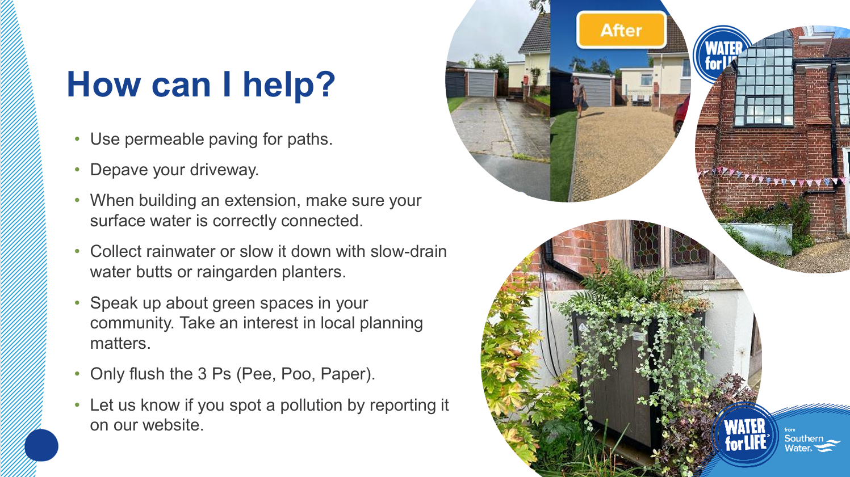

Slide 11
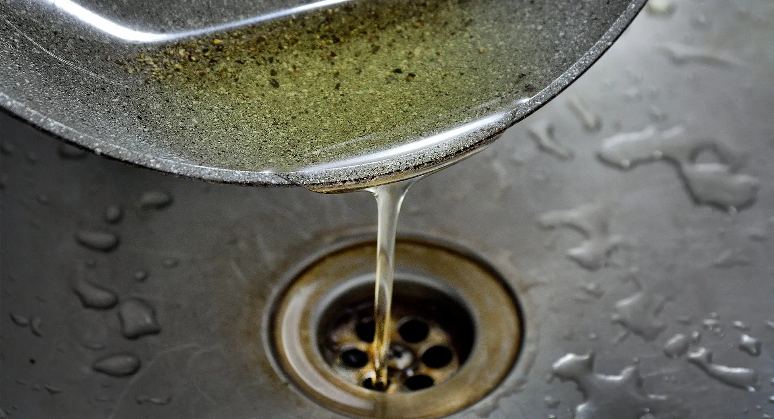

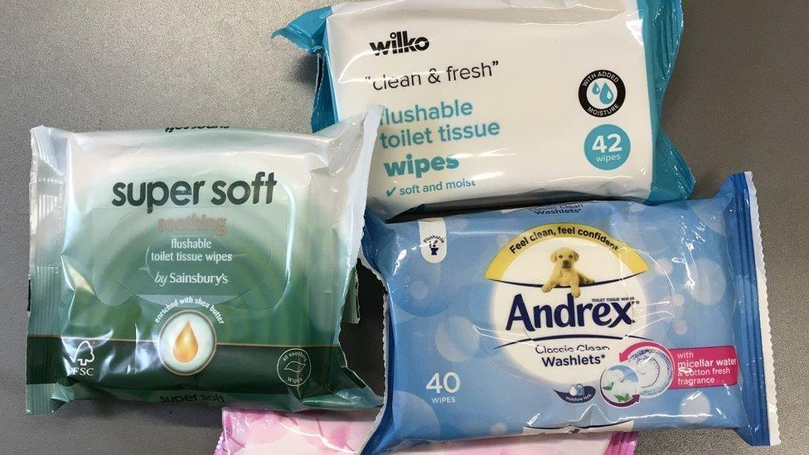

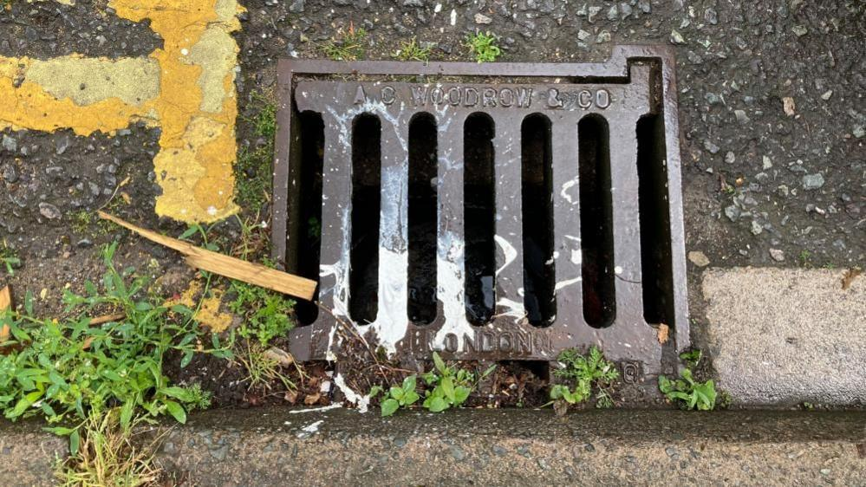
What else can we do?
Don’t treat the wastewater network like a bin
Get a sink strainer
Wipe greasy pans & baking trays with kitchen paper
Get a bathroom bin
Put your (cigarette) butt in a bin
Only put rain down the drain
There is no such thing as a flushable wipe
Reduce harmful chemicals entering water - Use eco-friendly cleaning products, reduce usage of pesticides/weedkillers, & pet flea treatments

Slide 12
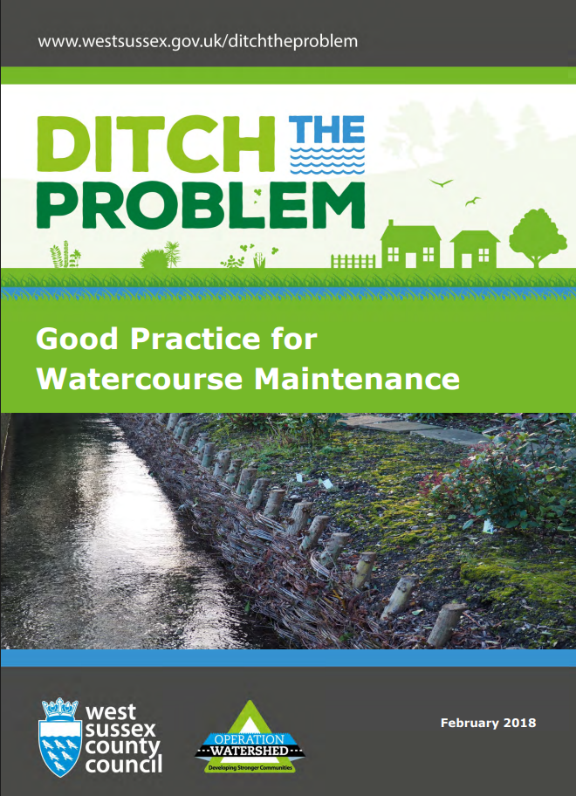
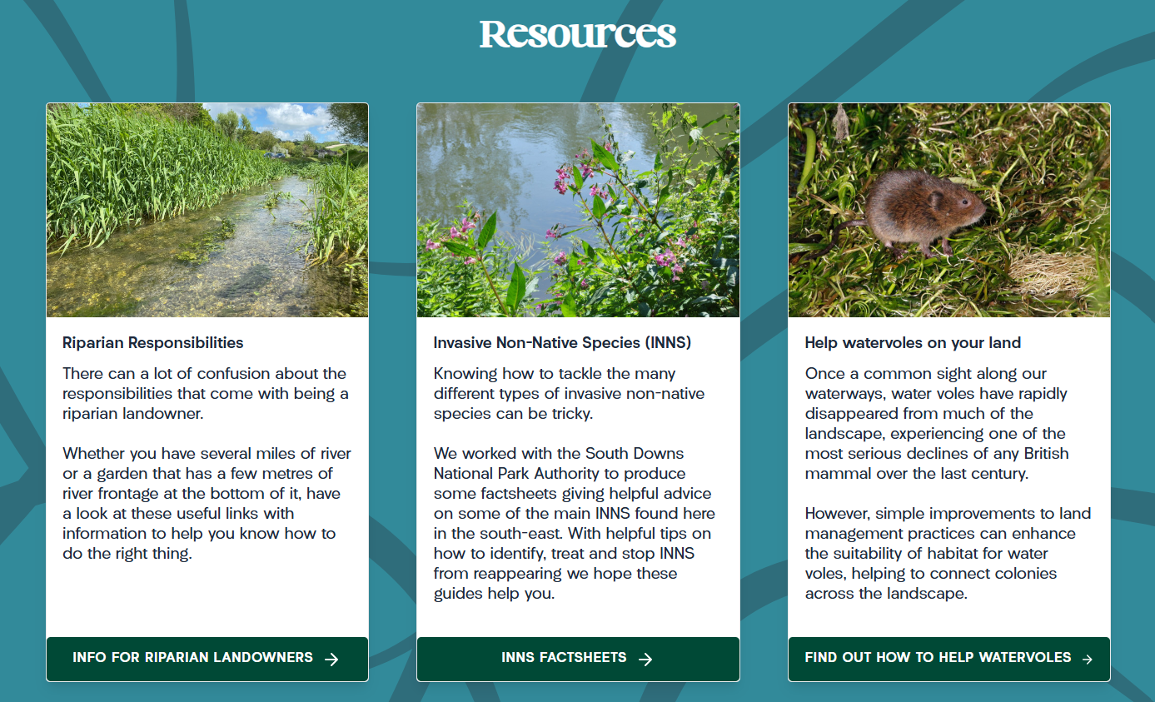

Riparian resources
Are you a riparian owner?
Do you need advice?
Do you have plans?
Contact WSRT!
Notes:
Rifes, ditches – better mgt, wide buffer zone

Slide 13
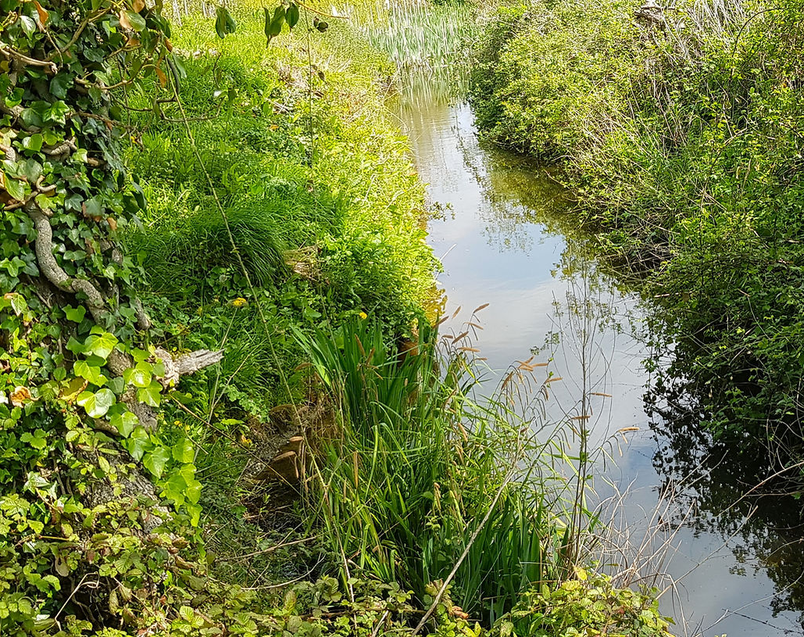
Riparian Responsibilities
Report a problem
Let water flow naturally
Prevent pollution
Protect wildlife

Slide 14
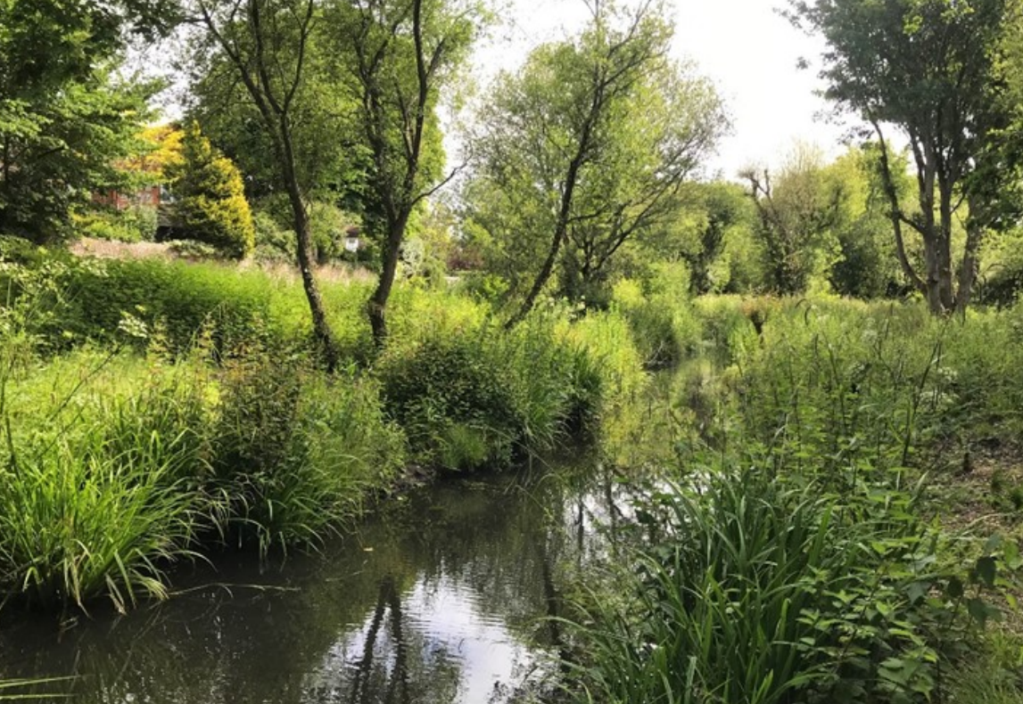
Better Ditches & Rifes
Ditches are better than culverts
Culverts – Bigger the better, inspect regularly & keep clear
Ditches –
Inspect regularly & keep clear
Manage during winter months
Manage vegetation on 3-year rotation - one side this year, one side next year, one year off
Remove hedge-cuttings / cut vegetation
Remove silt where necessary
Remove invasive non-native species

Slide 15
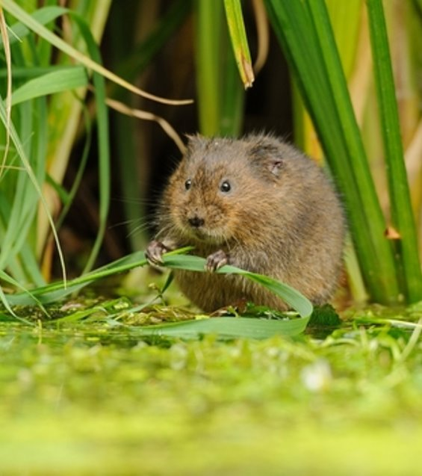

It’s not all about water voles …
Better Banks
+
Better Ditches
+
Better Ponds
More space for water, reduce flooding
Reduce pollution from runoff
Reduce pressure on sewage system
More water in the landscape in times of drought

Slide 16

Thank you Any Questions?
Name: Louise Barnetson
Role: Water Champion
Email: louise@wsrt.org.uk

