Slide 1

Community Emergency Hubs Stronger Together When It Matters Most

Slide 2
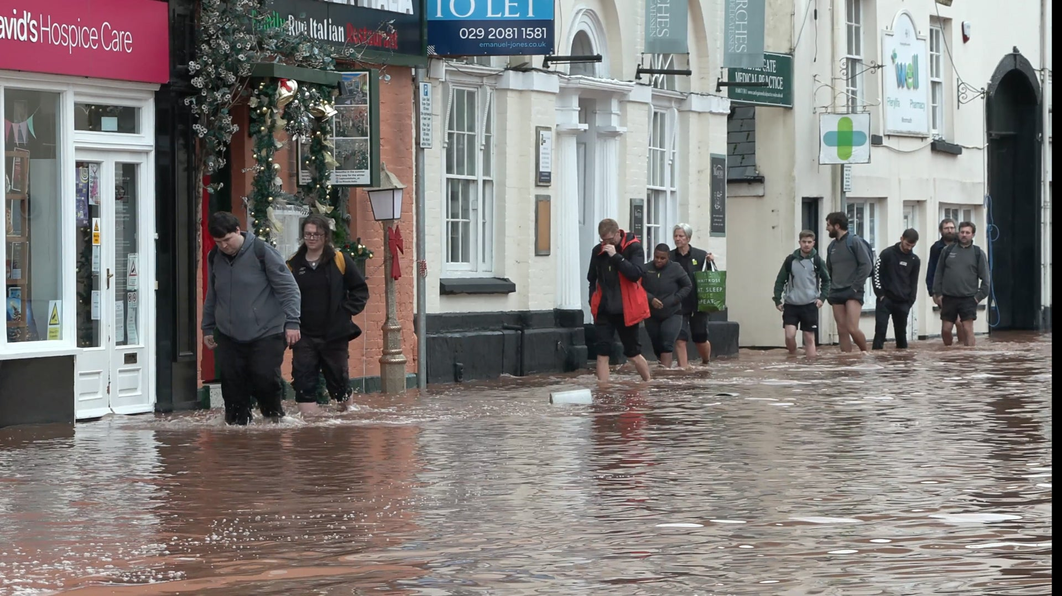
Power outage. Roads blocked. Phones struggling. Emergency Services stretched.
Then what?

Slide 3
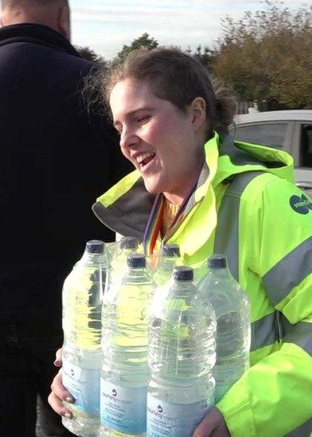

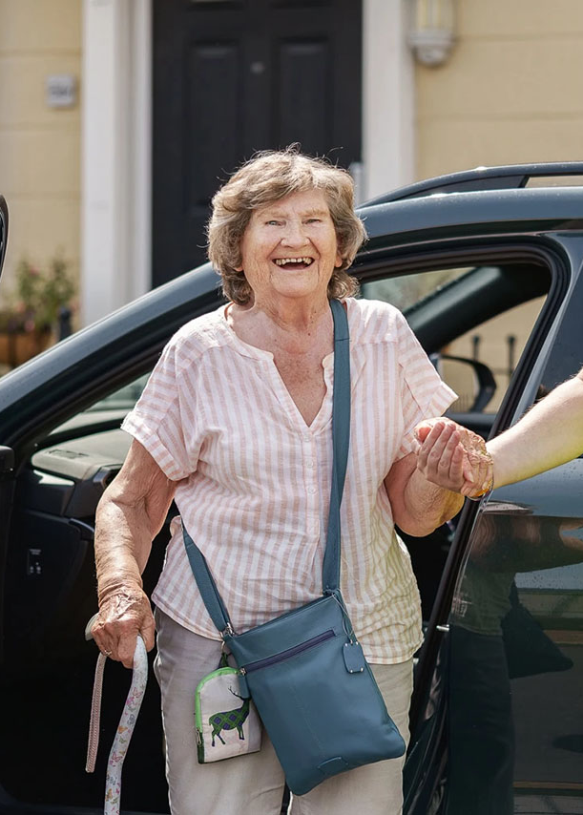
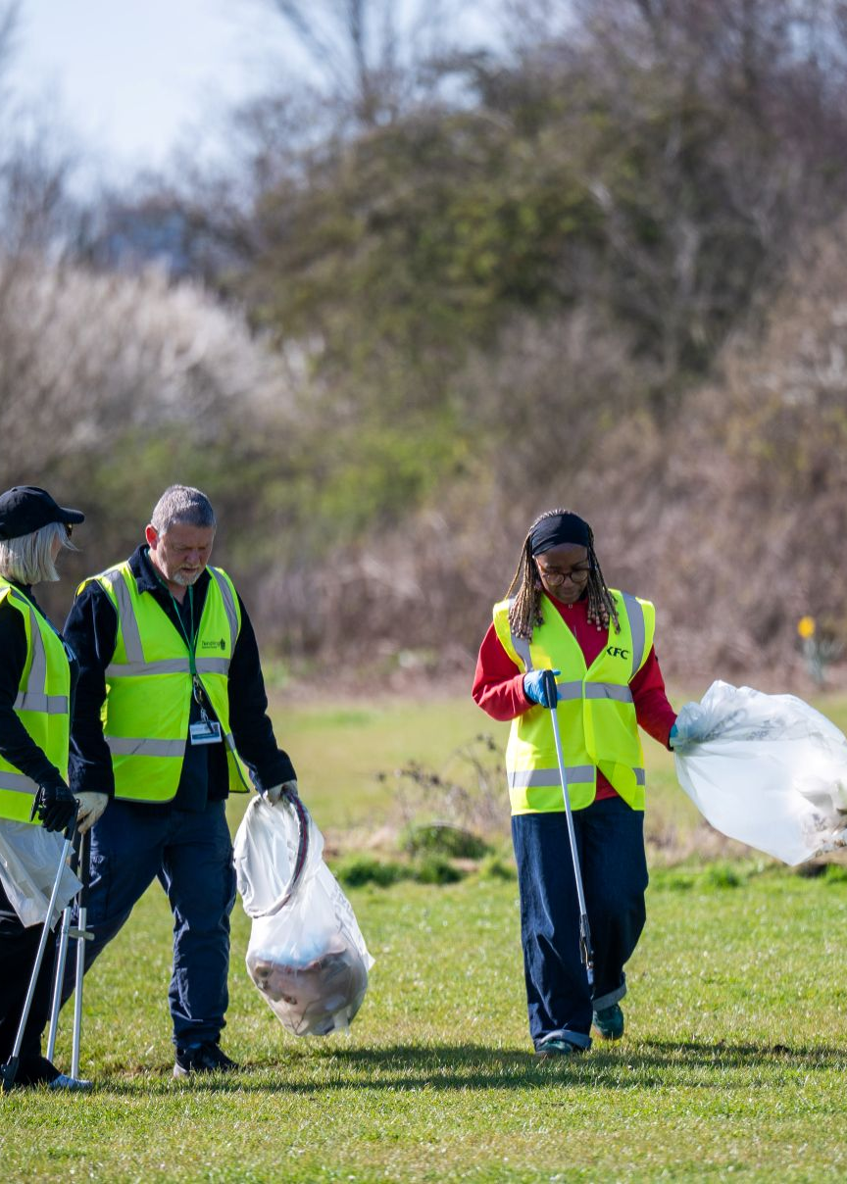
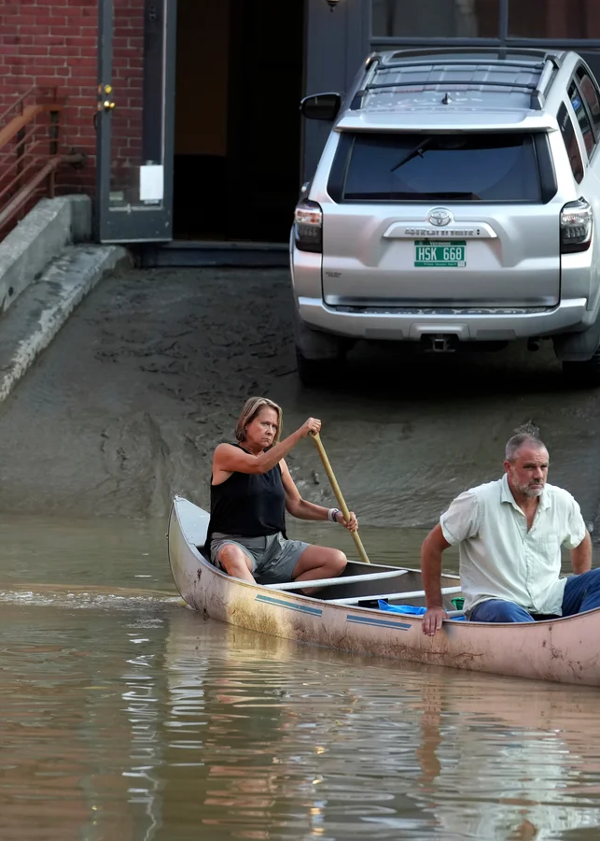
‘We help each other’

Slide 4



Community Emergency Hub
Notes:
A community emergency hub is based in a local place and run by local people.
The hub is ready to support the community in periods of disruption.

Slide 5

What does a Community Emergency Hub do?
In an emergency, a hub can:
Share trusted information
Co-ordinate local help
Provide a place for local people to gather
Notes:
A community emergency hub is a place for a community to coordinate its own efforts to help each other during and after a disruption.
It’s run by the community, for the community so its formed and operated by local people who turn up.

Slide 6
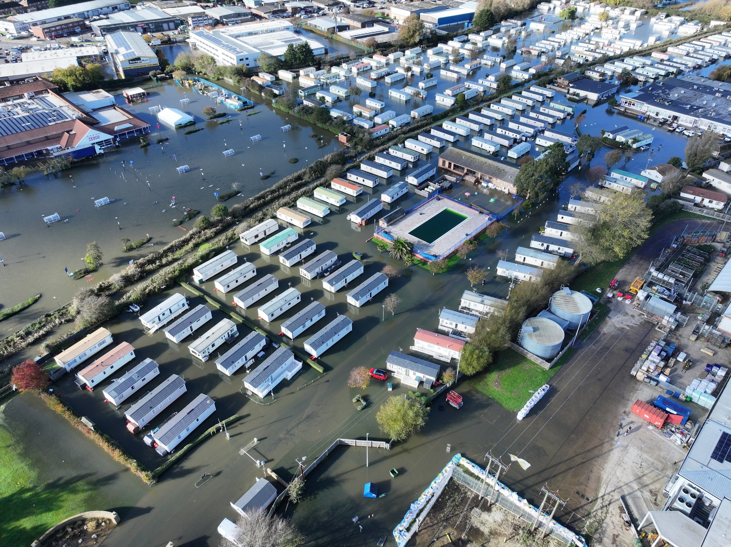
Why it matters in West Sussex
We’ve already experienced:
Flooding
Severe weather
Disruption
And it’s increasing

Slide 7
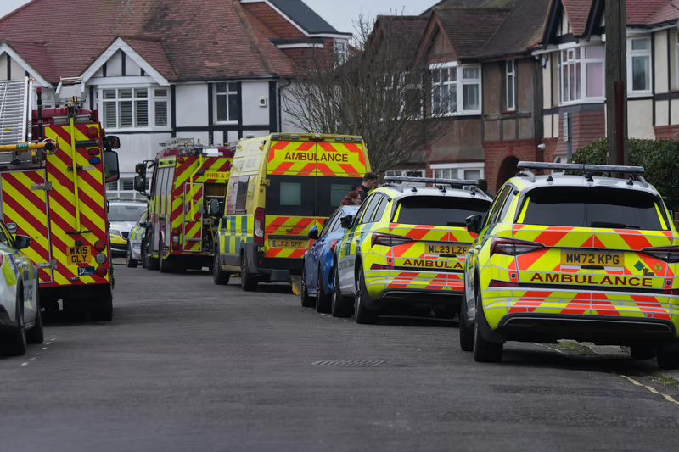

Emergency services can’t be everywhere
But communities already are

Slide 8

Simple. Practical. Community-led.
You only need:
A few people
A local place
A bit of guidance
Notes:
You know your area best
Start small, grow over time
Focus on what actually helps your community

Slide 9
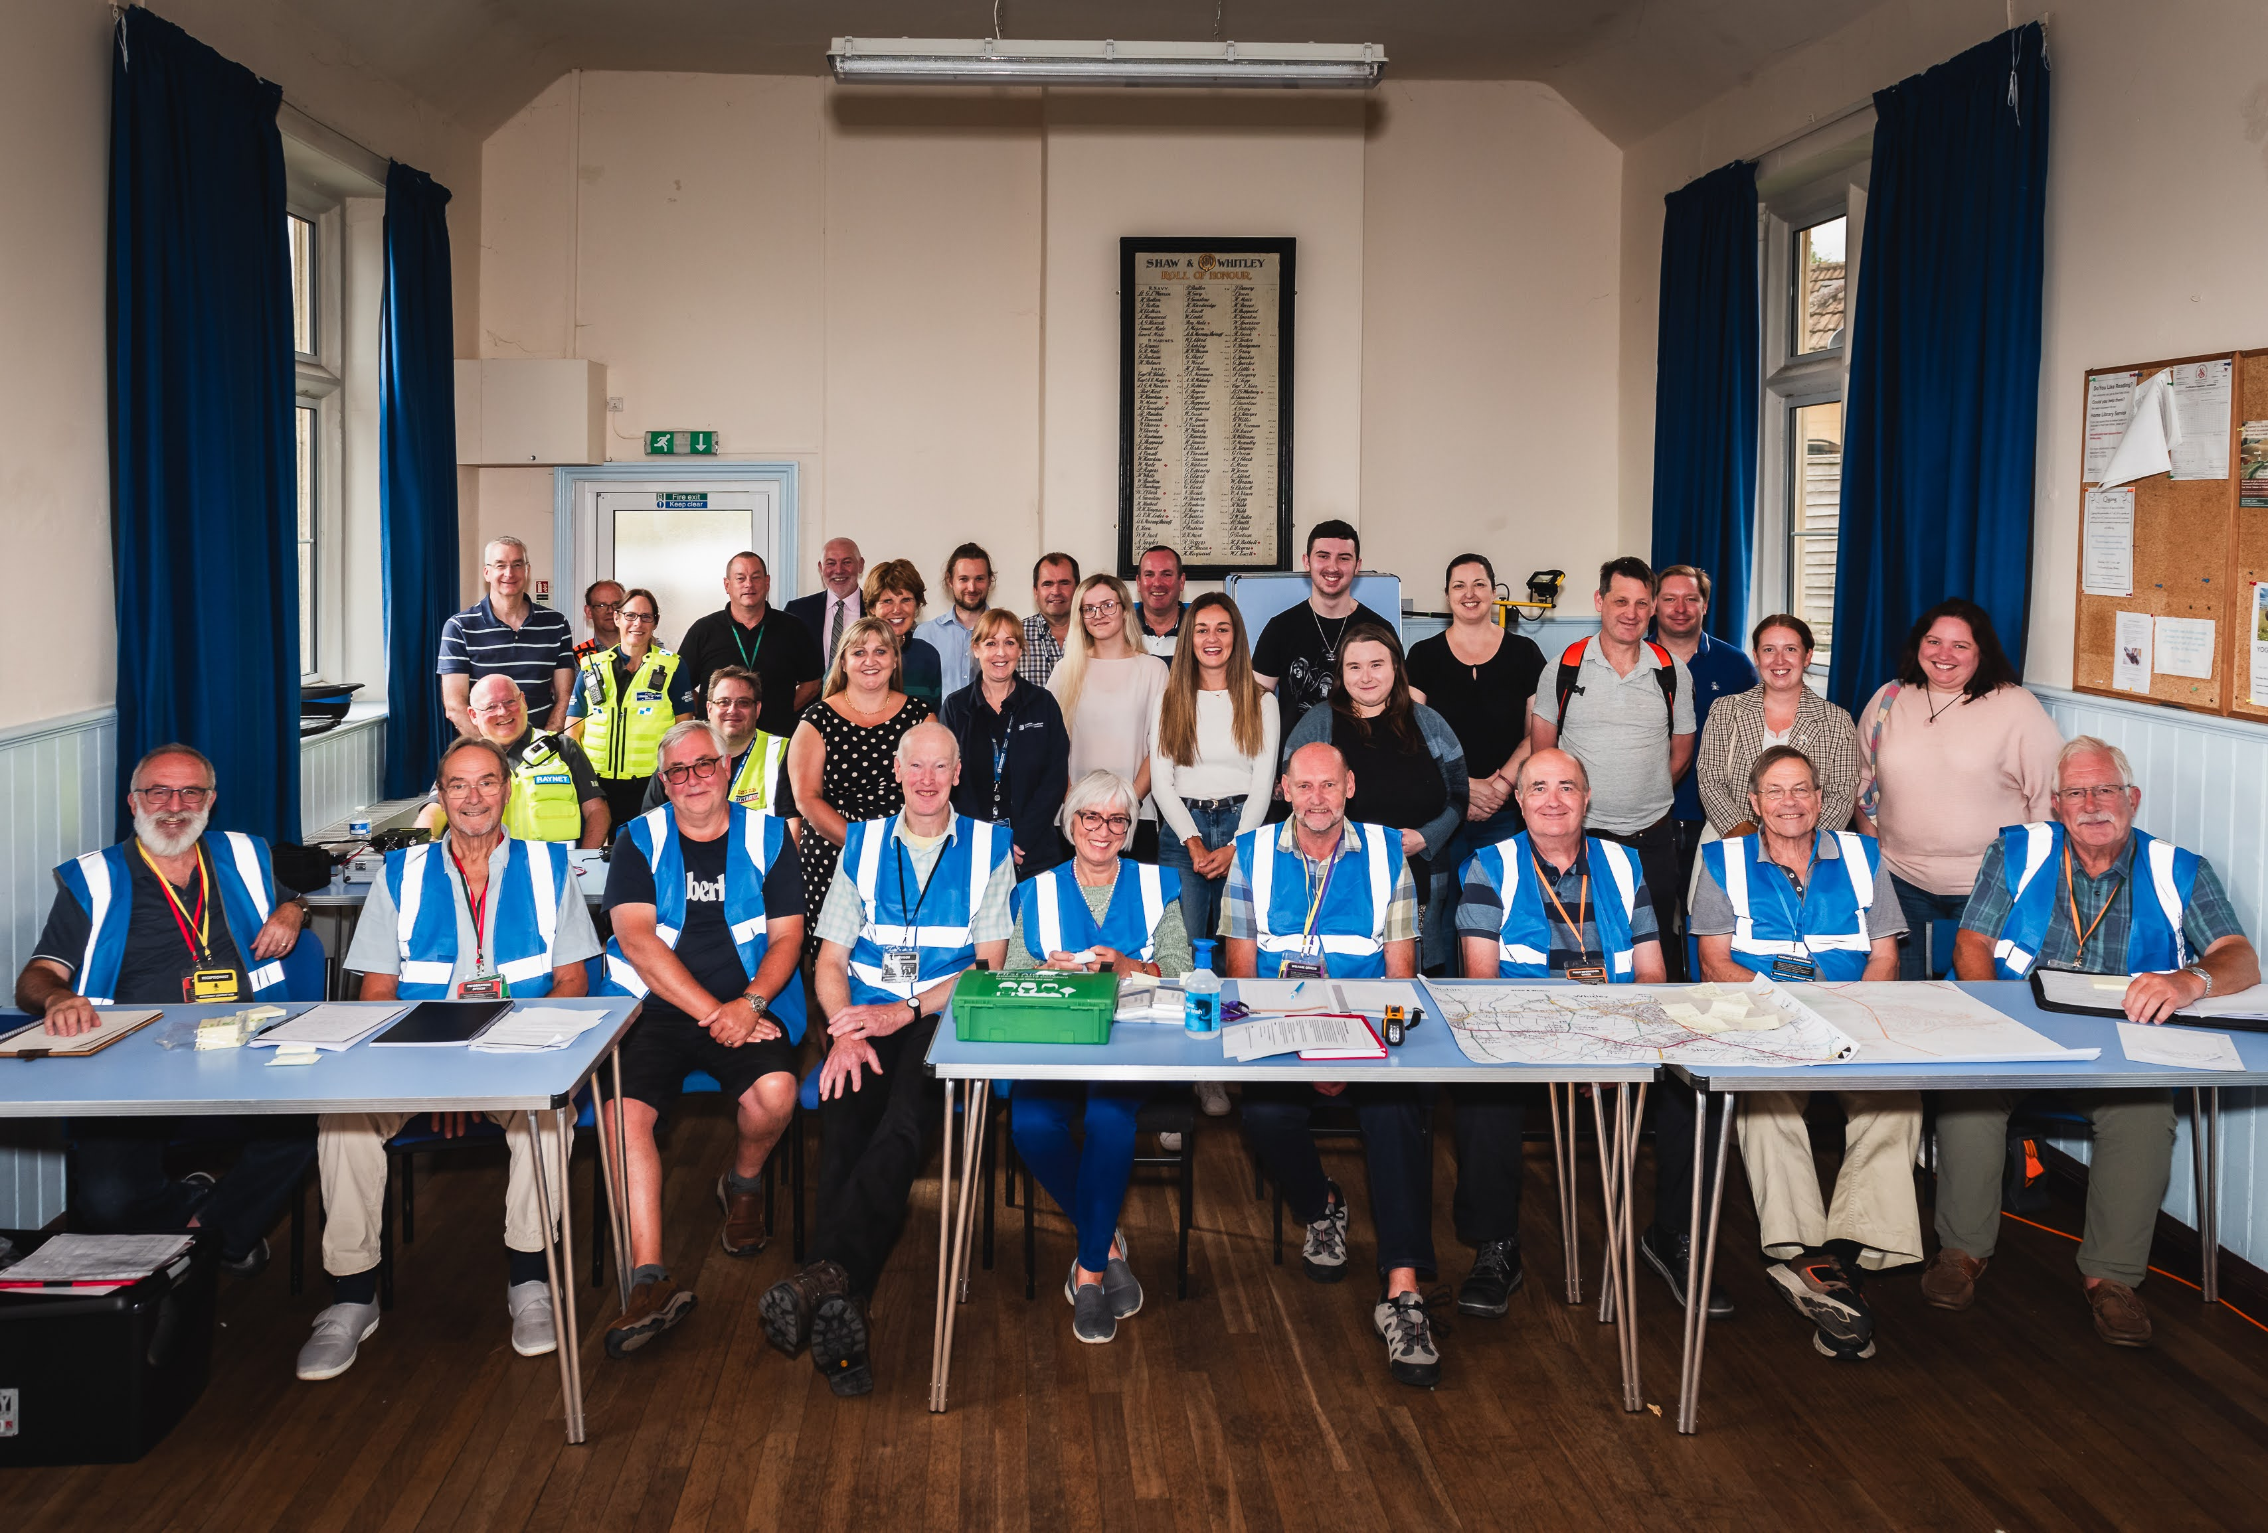
Would your community be ready tomorrow? Get involved today Start a hub in your local area

