Slide 1
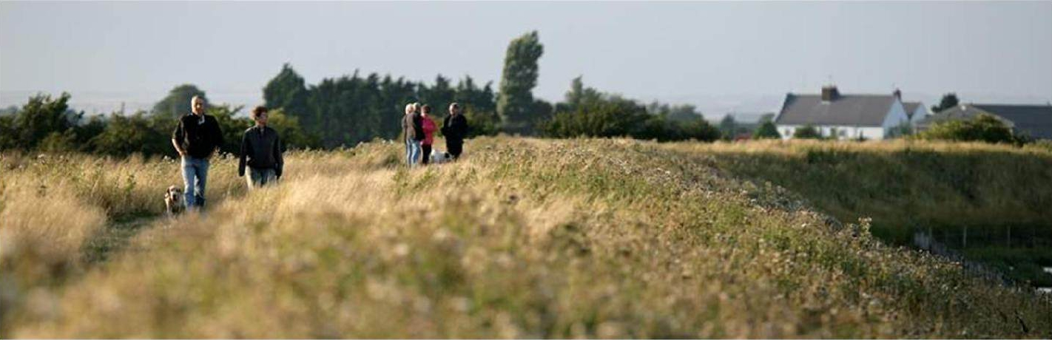


Manhood Peninsula Partnership
May 2025

Slide 2
Manhood Peninsula Partnership
The MPP is a Standing Conference for the
Manhood Peninsula
The Manhood Peninsula Partnership (MPP)
aims to promote, develop and support initiatives
that deliver social, environmental and economic benefits
to the coastal communities of the
Manhood Peninsula.

Slide 3
Manhood Peninsula Partnership
The MPP is a Standing Conference for the
Manhood Peninsula
The term Standing Conference describes a forum enabling partner organisations to identify collaborations and roadblocks…
... it enables knowledge sharing about local concerns, and the delivery of projects benefitting the peninsula by working with parishes, local government, local representatives of national bodies, local groups, academia and NGOs.
The MPP is administered by Chichester District Council but locally driven

Slide 4
Manhood Peninsula Partnership
The MPP is a Standing Conference for the
Manhood Peninsula
MPP initiatives result from local concerns:
Lack of integrated and long-term planning
Recognition of infrastructure deficits
Recognition of future risks particularly climate change
Recognition of POTENTIAL of area:
  3 pillars of sustainability - community; environment; and economy.
It is not a collective political lobbying body and does not comment on planning matters

Slide 5
Manhood Peninsula Partnership
The aims of the MPP are:
To ensure the sustainable development of the peninsula for the benefit of future generations and to consider long-term issues, including climate change.
To improve and promote inter-sectoral integration, co-ordination, communication and understanding between those involved in the Manhood Peninsula.
To provide opportunities for wider community participation and interaction.
To encourage a proactive approach to addressing the effects of climate change and other issues.
The development and implementation, or assistance with the implementation, of guidelines, strategies and action plans.
The exploration and research of different options and the need to learn from other areas.

Slide 6
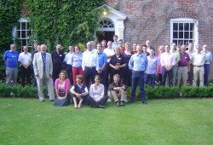
Manhood Peninsula Partnership
Origins of the partnership:
Going Dutch Workshop, March 2001, Earnley Concourse.
Initiated by two local residents, a risk management journalist and a Dutch water management professional from NIROV.
Participants: planning, water, coastal management, infrastructure and environmental specialists from the UK and Netherlands Institute for Spatial Planning and Housing (NIROV).
NIROV holds an annual ‘blue sky thinking’ workshop. Going Dutch was first workshop abroad.

Slide 7
Tangible Benefits
ESPACE
  Haskoning Land Drainage study; ESPACE Adaptation Action Plan
Defra Coastal Change Pathfinder Project
  Towards ICZM, Destination Management Plan, Coastal Change Grant Fund, Coastal Literacy, support for the FLOW project – MWHG
Local liaison:
  Sustainable transport ideas and projects
  Medmerry; climate change; flooding; and water management issues.
  The marine environment, tourism and economy
Selsey Haven feasibility study – Coastal Communities Fund.
‘Seas the Day; the Fishermen of Selsey Bill’ – National Lottery Heritage Fund.
Visions projects for East Wittering & Bracklesham and Selsey.
UK Shared Prosperity Fund (UKSPF) and Rural England Prosperity Fund (REPF).

Slide 8



Invisible benefits
Outstanding example of successful community/ local government/ national agency engagement & partnership.
Increased public optimism and local pride.
Putting the Manhood Peninsula on the map!
Vehicle to initiate, enable and deliver future projects.

Slide 9
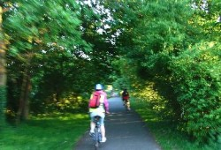
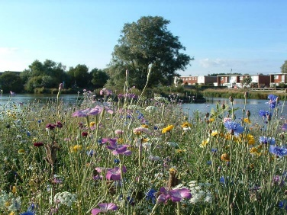
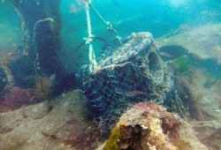
What’s happening now?
The MPP is the umbrella organisation within which there are currently 3 subgroups…
GLaM: Green Links across the Manhood Peninsula
SWISh: Surface Water Issues and Solutions
CHASM: Crustaceans, Habitat And Sediment Movement

Slide 10
What’s happening now?
GLaM
…aims to enhance the visitor experience and support sustainable transport measures on the coastal plain by capitalising on existing footpaths and green links; creating and improving circular green routes across the peninsula; creating a Sustainable Transport Plan for the Manhood Peninsula.

Slide 11
What’s happening now?
GLaM
Walking, cycling and horse riding on the peninsula will reduce traffic congestion, encourage people to get out of their cars to improve health, and provide a focus for the visitor economy of the peninsula. Partners, including Sustrans are looking at:
Active Travel
Restoring the Record
The Case for Quiet Lanes on the Manhood Peninsula

Slide 12

What’s happening now?
SWISh
…aims to build and maintain resilience to address concerns with the water cycle arising from climate change, flooding from coasts, rivers and rifes; water conservation during increasing periods of drought.

Slide 13

What’s happening now?
SWISh
SWISh: working group of Local Flood Action Groups on the Manhood and organisations that have a direct responsibility for drainage and flood defence. Partners are looking at:
Scheme of local management of surface water drainage and flood risk on the Peninsula.
WSCC Climate Vulnerability Index
Changes in local water management
Joint Sidlesham and Selsey flood group pilot
Rain Gardens and rewilding management of grass verges

Slide 14

What’s happening now?
CHASM
…aims to identify causes behind changes in the marine environment:
the decline in crab and lobster catch, the decline in sea water and marine habitat quality, and the increased quantity of marine sediment initially observed by the Fishermen of Selsey Bill.

Slide 15
What’s happening now?
CHASM
Something has affected the marine environment, but it isn't clear what that is. Observations indicate a huge range of potential environmental stressors involved. normally examined on an individual rather than a holistic basis instead of the combined effects. Partners are looking at:
Pharmaceuticals and pesticides in Bracklesham Bay lobsters
Cefas Crab Survey
Habitat restoration and role of sediments/changing coasts
Sussex Estuaries Project

Slide 16
MPP Partners
Chichester District Council (MPP Secretariat)
Chichester Harbour Conservancy
Coastal Partners
Environment Agency
Manhood Wildlife & Heritage Group (MWHG)
Marine Management Organisation (MMO)
National Trust
Natural England
Parish Councils on the Manhood Peninsula
Royal Society for the Protection of Birds (RSPB)
Selsey Town Council
Sussex Association of Local Councils
Sustrans
The Great Sussex Way
Universities
West Sussex County Council
Wittering Estate

Slide 17








Film
Celebrating the Manhood Peninsula Coastline
Film 1: Celebrating the Manhood Peninsula coastline
Chichester Coastal Change Pathfinder Project
Funded by Defra
Institute of Marine Sciences
School of Applied Sciences

Slide 18
Film
The Fishermen of Selsey Bill
Sea's the Day:
The Fishermen of Selsey Bill (youtube.com)
Institute of Marine Sciences
School of Applied Sciences

Slide 19
Film
The Crustaceans Habitat and Sediment Movement Project (CHASM)
The Crustaceans Habitat and Sediment Movement Project (CHASM) (youtube.com)
Institute of Marine Sciences
School of Applied Sciences

Slide 20
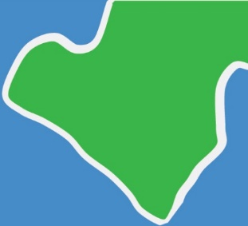
Contact:
Jane Cunningham
MPP Project Officer, Chichester District Council
jcunningham@chichester.gov.uk
Manhood Peninsula Partnership
www.peninsulapartnership.org.uk

